Slide 1




NEXT GEN EMPLOYABILITY PROGRAM
Creating a future-ready workforce
Team Members
College Name
Student Name :Alagia Annapoorani.S
Student ID :au912421104003
SEC

Slide 2

CAPSTONE PROJECT SHOWCASE
Project Title
VOTING APPLICATION USING DJANGO FRAMEWORK
Abstract | Problem Statement | Project Overview | Proposed Solution | Technology Used | Modelling & Results | Conclusion

Slide 3
Abstract
The Voting Application is a web-based platform developed using the Django framework, designed to facilitate fair and efficient voting processes for various purposes such as elections, surveys, or opinion polls. The application provides users with a secure and user-friendly interface to cast their votes, view voting results, and manage administrative tasks.
Key Features:
Voting Process:
Users can view available ballots and cast their votes securely.
The application ensures that each user can vote only once per ballot.
Depending on the type of ballot, users can select one or multiple options or rank choices according to their preferences.
Source :

Slide 4
Problem Statement
In modern society, the need for efficient and secure voting systems has become increasingly apparent. Traditional paper-based voting methods are often time-consuming, prone to errors, and lack transparency. Moreover, with the rise of digital technology, there is a growing demand for online voting platforms that can accommodate remote participation while ensuring the integrity and confidentiality of the voting process.
Key Challenges:
Security
User Experience
Scalability
Administration Tools
Legal and Regulatory Compliance
Source :

Slide 5
Project Overview
Introduction:
The Voting Application is a web-based platform developed using the Django framework, aimed at facilitating fair and secure voting processes for various purposes such as elections, surveys, and opinion polls.
Development Process:
Agile methodology with iterative development cycles, continuous integration, and frequent feedback from stakeholders.
Divide the project into smaller tasks, such as user authentication, ballot creation, voting process, etc., and prioritize them based on importance and dependencies.
Features:
User Authentication and Authorization: Implement user registration, login, and access control mechanisms to ensure secure access to the platform.
Conclusion:
The Voting Application aims to provide a reliable, secure, and user-friendly platform for conducting various voting activities, promoting democratic participation, transparency, and trust in the electoral process.
Technologies:
Backend: Django framework for server-side logic, ORM, and routing.
Frontend: HTML, CSS, JavaScript, and frameworks like Bootstrap for responsive design and interactivity.
Source :

Slide 6
Proposed Solution
Overview:
The proposed solution is to develop a robust, secure, and user-friendly Voting Application using the Django framework. The application will provide a platform for conducting different types of elections, surveys, and polls while ensuring integrity, confidentiality, and accessibility.
.
Real-time Results:
Calculate and display voting results in real-time using dynamic charts, graphs, and tables.
Enable users to track the progress of ongoing voting activities and view final results once voting is completed.
Testing and Quality Assurance:
Conduct thorough testing, including unit tests, integration tests, and end-to-end tests, to ensure the reliability and functionality of the application.
Perform security testing, vulnerability assessments, and penetration testing to identify and mitigate potential security risks.
Key Components:
User Authentication and Authorization:
Implement user registration, login, and password reset functionalities.
Differentiate between administrators and regular users with varying levels of access rights.
Source :

Slide 7
Ballot Management:
Allow administrators to create, edit, and delete ballots.
Support various types of ballots such as single-choice, multiple-choice, and ranked-choice.
Enable customization of ballot titles, descriptions, options, and voting rules.
Voting Process:
Provide users with a user-friendly interface to view available ballots and cast their votes securely.
Ensure that each user can vote only once per ballot to maintain the integrity of the voting process.
Handle different voting methods, including direct voting, proxy voting, and absentee voting.
Administration Panel:
Develop an intuitive dashboard for administrators to manage users, monitor voting activity, and analyze results.
Include features for generating reports, exporting voting data, and conducting audits.
Implement role-based access control to restrict access to sensitive administrative functionalities.
Security and Compliance:
Implement robust security measures to protect user data and prevent unauthorized access or tampering.
Encrypt sensitive information, use HTTPS for secure communication, and follow best practices for secure coding.
Ensure compliance with relevant legal and regulatory requirements, including data protection laws and electoral regulations.
Source :

Slide 8
Scalability and Performance:
Design the application with scalability in mind to handle a large number of users and concurrent voting activities.
Optimize database queries, cache frequently accessed data, and utilize asynchronous processing to improve performance.
Deploy the application on scalable infrastructure such as cloud platforms to accommodate varying workloads.
Conclusion:
The proposed solution aims to address the challenges associated with traditional voting methods by providing a modern, secure, and efficient platform for conducting elections and polls. By leveraging the Django framework and best practices in software development, the Voting Application will empower organizations, communities, and individuals to engage in democratic processes with confidence and transparency.
Source :

Slide 9


Technology Used
Front-end
Back-end
Source :

Slide 10
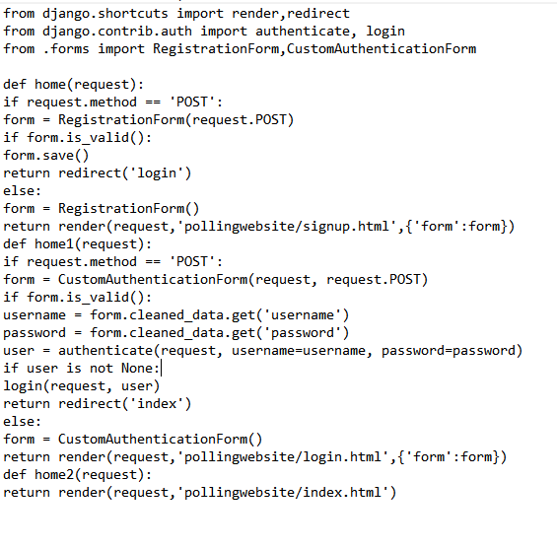
Modelling & Results
.
.
Source :

Slide 11
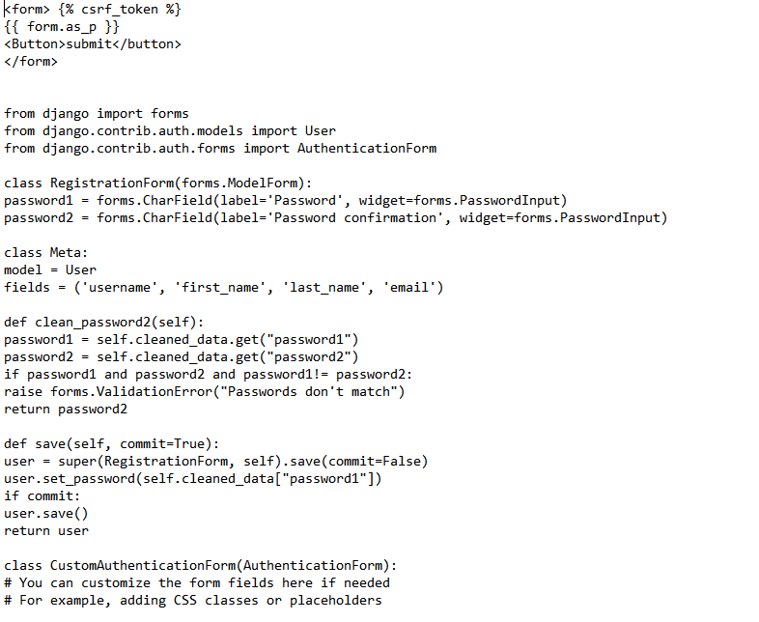
Modelling & Results

Slide 12
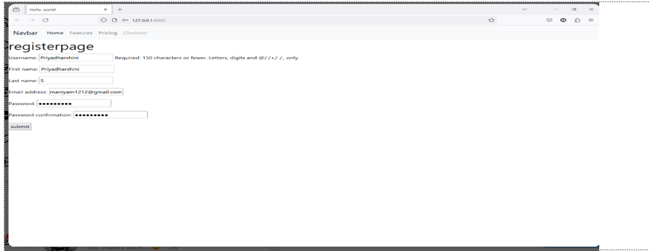
Homepage

Slide 13
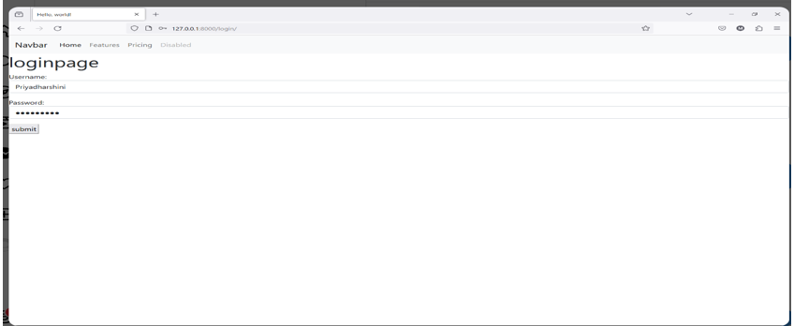
About-Us-Page

Slide 14
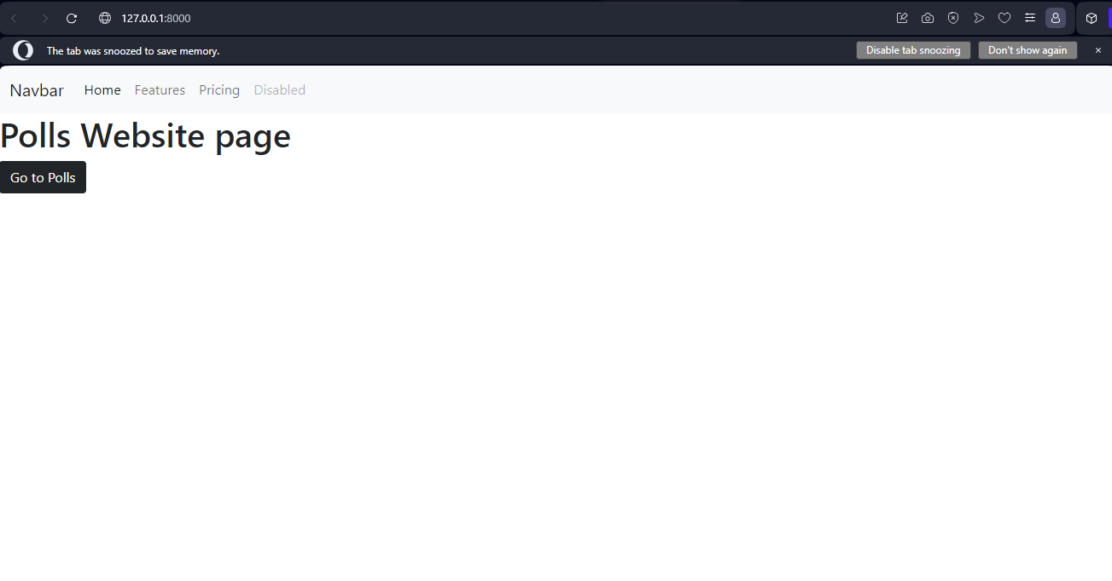
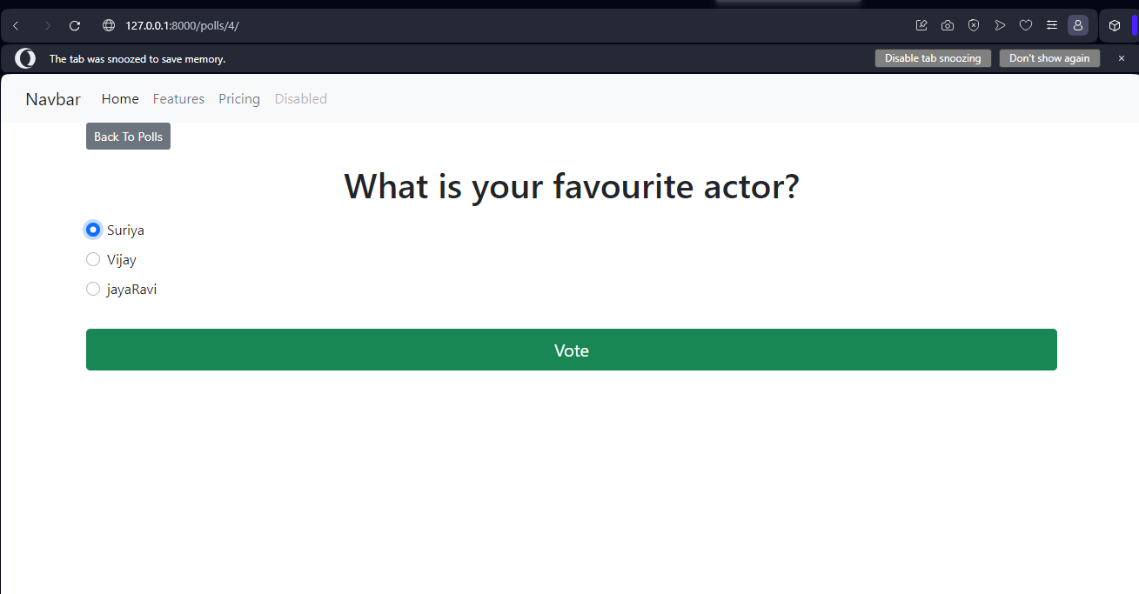
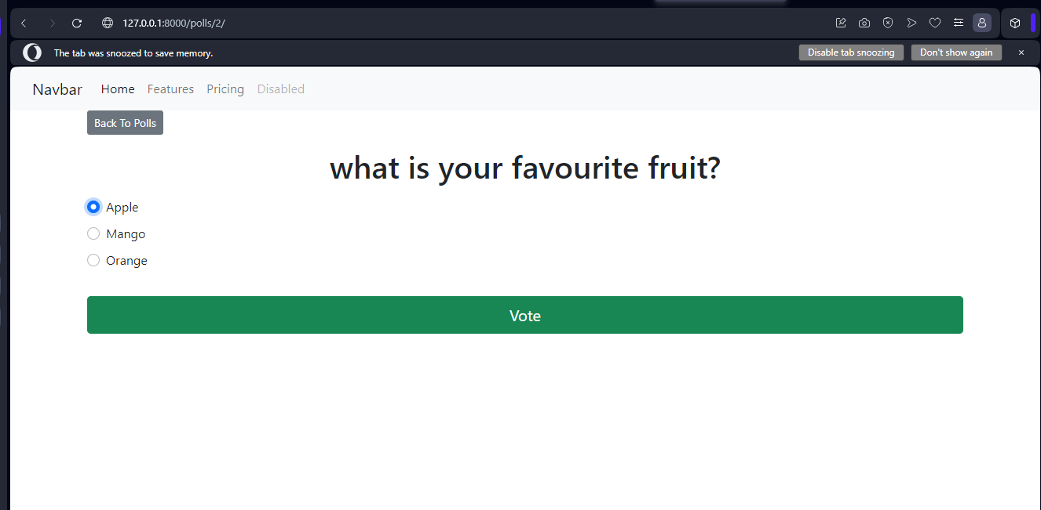
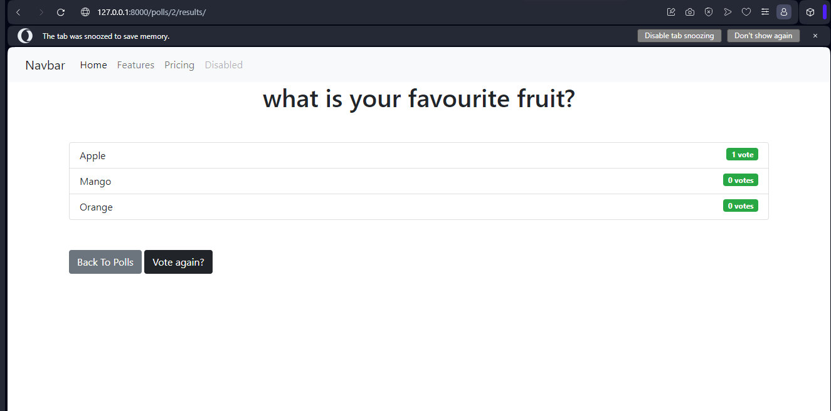
Service-Page

Slide 15
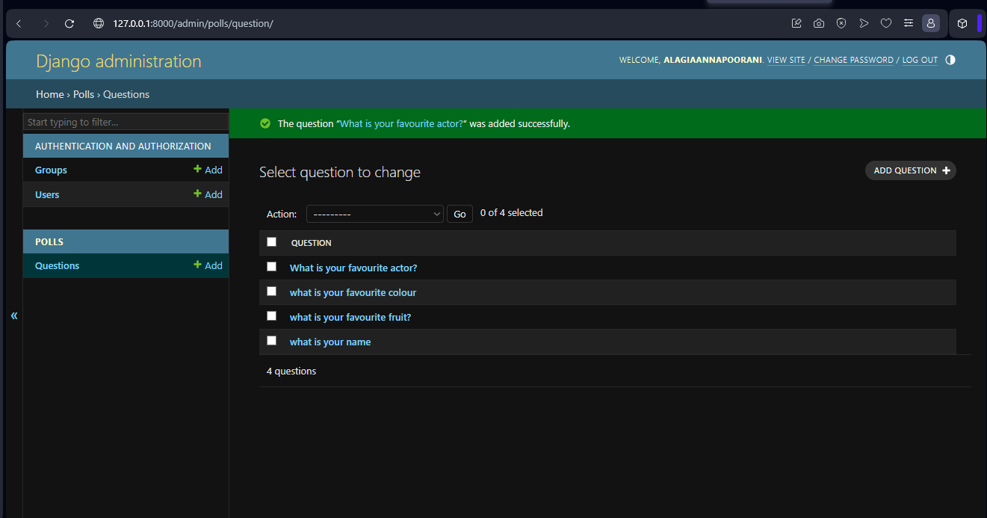
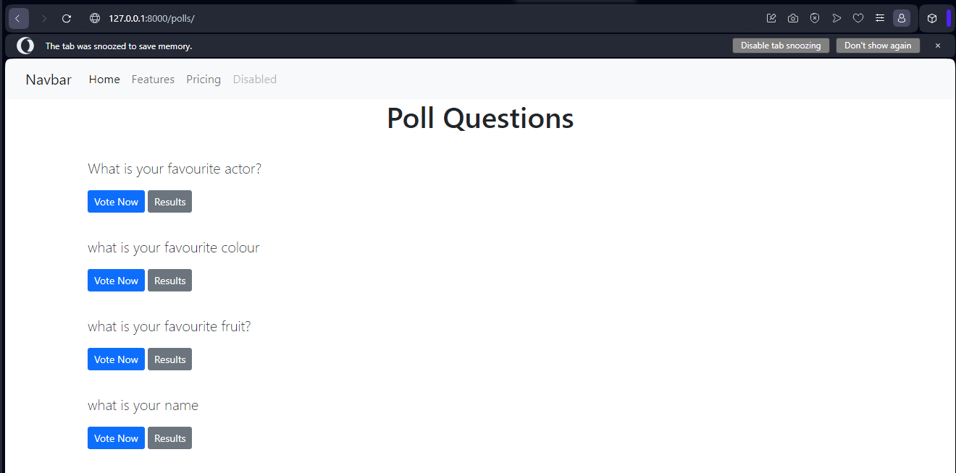
Departments-Page

Slide 16
Blog-Page
Creating a blog page for your Django-based voting application is a great way to engage with your users, share updates, and provide additional context around the polls and voting process. Here's how you can implement a simple blog page using Django
Create Blog Posts:
Now you can create blog posts using Django's admin interface (admin.py), or you can provide a form for administrators to create new posts within the application.
Styling:
Apply CSS styling to your blog templates to enhance the appearance and layout of your blog page.
With these steps, you'll have a basic blog page integrated into your Django voting application. Users can navigate to the blog to read posts related to polls, voting updates, announcements, or any other content you want to share with your audience.
Create a Blog App:
Start by creating a new Django app to handle the blog functionality.
Define Models:
Define models for blog posts in your blog/models.py file.

Slide 17
Future Enhancements:
Real-time Updates:
Use JavaScript and AJAX to update the voting results in real-time without requiring a page refresh whenever a user submits their vote.
Interactive Charts:
Enhance the results page with interactive charts or graphs to visually represent the voting data.
Admin Dashboard:
Create an admin dashboard where administrators can manage polls, view voting statistics, and analyze voting trends.
Email Notifications:
when they successfully vote, or when the voting results are Send email notifications to users when new polls are created, published.
Social Media Integration:
Allow users to share polls on social media platforms such as Facebook, Twitter, or LinkedIn to increase engagement and reach a wider audience.
User Authentication:
Implement user authentication to allow only registered users to vote. This can prevent duplicate voting and ensure the integrity of the voting process.
Multiple Choice Questions:
Extend the application to support multiple-choice questions where users can select more than one choice for each poll.
Voting Restrictions:
Implement restrictions such as allowing users to vote only once per poll or limiting the time frame during which users can vote.
Anonymous Voting:
Provide an option for users to vote anonymously if they prefer not to disclose their identity.

Slide 18
Conclusion
URL Routing:
We defined URL patterns to map views to specific URLs, enabling navigation within the application.
Database Migration:
We used Django's migration system to create and synchronize database tables based on our model definitions.
Future Enhancements:
We discussed potential enhancements such as user authentication, multiple-choice questions, real-time updates, and more to further improve the application's functionality and user experience.
In conclusion, developing a voting application using the Django framework provides a solid foundation for creating a robust and scalable solution. Throughout the development process, we've covered several key aspects
Setup and Configuration:
We started by setting up a Django project and creating a new app to handle the voting functionality.
Model Definition:
We defined models to represent polls and choices, which serve as the core data structures for our application.
Views and Templates:
We implemented views to render HTML templates for displaying polls, allowing users to vote, and showing voting results.
Source :

Slide 19
Thank You!
Notes:
Thank You !!

